Slide 1



Slide 2
Course: Mastering Microsoft Azure
Lecture on:
Instructor: Siddhesh Prabhugaonkar

Slide 3
Configure Azure App Service Plans

Slide 4
Learning Objectives: Configure Azure App Service Plans
Implement Azure App Service Plans
Determine the App Service Plan Pricing
Scale Up and Scale Out the App Service Plan
Configure App Service Plan Scaling
Configure Azure App Service Plans: Demonstration
Learning Recap
Implement and manage Azure compute resources (20%–25%)
Create and configure the Azure App Service
Provision an App Service plan
Configure scaling for an App Service plan

Slide 5

Implement Azure App Service Plans
Determines the performance, price and features
Defines a set of compute resources for a web app to run:
  Region where compute resources will be created
  Number of virtual machine instances
  Size of virtual machine instances
  Pricing tier (next slide)
One or more apps can be configured to run in the same App Service plan

Slide 6
Determine App Service Plan Pricing
Selected Features | Free | Shared (dev/test) | Basic (dedicated dev/test) | Standard (production workloads) | Premium (enhanced scale and performance) | Isolated (high-performance, security and isolation)
Web, mobile or API apps | 10 | 100 | Unlimited | Unlimited | Unlimited | Unlimited
Disk space | 1 GB | 1 GB | 10 GB | 50 GB | 250 GB | 1 TB
Auto Scale | – | – | – | Supported | Supported | Supported
Deployment slots | 0 | 0 | 0 | 5 | 20 | 20
Max instances | – | – | Up to 3 | Up to 10 | Up to 30 | Up to 100
Shared compute (Free and Shared) Run apps on
the same Azure VM as other App Service apps, and the resources cannot scale out
Dedicated compute
(Basic, Standard and Premium)
Run apps in the same plan in dedicated Azure VMs
Isolated
Runs apps on dedicated Azure VMs in dedicated Azure virtual networks

Slide 7
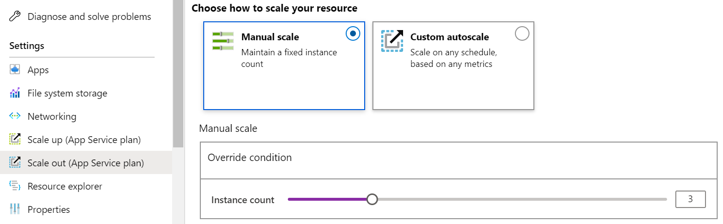
Scale Up and Scale Out the App Service Plan
Scale up (change the App Service plan):
  More hardware (CPU, memory and disk)
  More features (dedicated virtual machines, staging slots and autoscaling)
Scale out (increase the number of VM instances):
  Manual (fixed number of instances)
  Autoscale (based on the predefined rules and schedules)

Slide 8
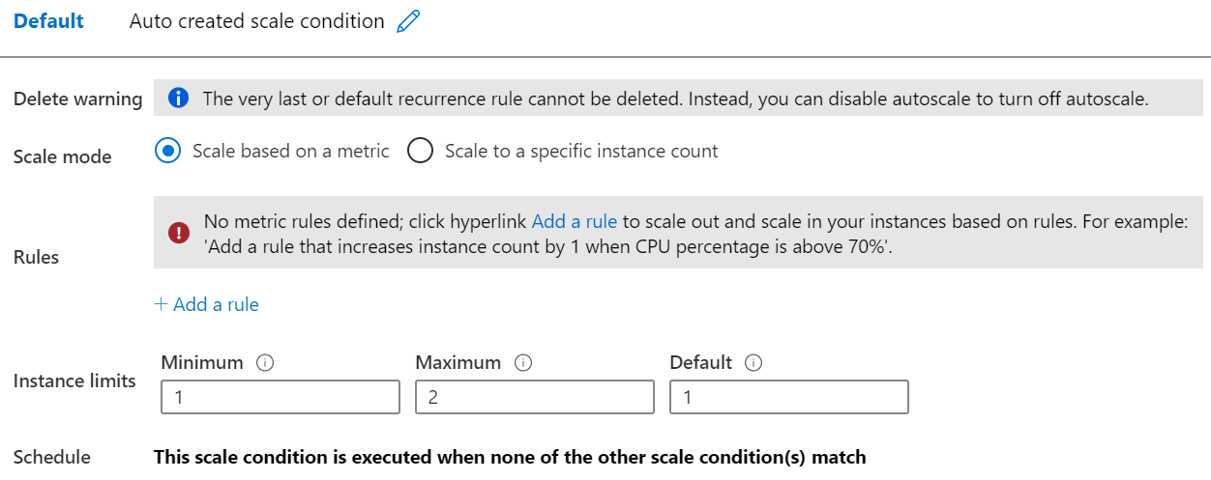
Configure App Service Plan Scaling
Adjust the available resources based on the current demand
Improves availability and fault tolerance
Scale based on
a metric (CPU percentage, memory percentage and HTTP requests)
Scale according to a schedule (weekdays, weekends, times and holidays)
Can implement multiple rules - combine metrics and schedules
Do scale in

Slide 9
Configure App Service Plans: Demonstration
Create and deploy a simple App Service Plan
Review scaling options

Slide 10
Configure Azure App Services

Slide 11
Learning Objectives: Configure Azure App Services
Implement the Azure App Service
Create an App Service
Create Deployment Slots
Add Deployment Slots
Secure an App Service
Create Custom Domain Names
Back up an App Service
Azure App Services: Demonstration
Learning Recap
Implement and manage Azure compute resources (20%–25%)
Create and configure the Azure App Service
Create an App Service
Configure certificates and TLS
Map an existing custom DNS name
Configure backup
Configure networking settings
Configure deployment slots

Slide 12
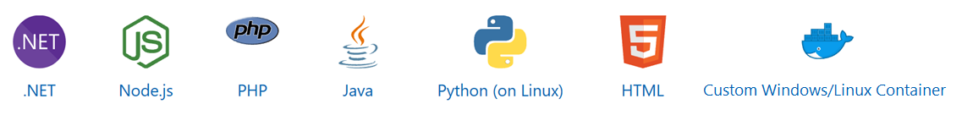
Implement Azure App Service
Includes Web Apps, API Apps, Mobile Apps and Function Apps
Fully managed environment enabling high productivity development
Platform-as-a-service (PaaS) offering for building and deploying highly available cloud apps
for web and mobile
Platform handles the infrastructure so that developers can focus on core web apps and services
Developer productivity using .NET, .NET Core, Java, Python and a host of others
Provides enterprise-grade security and compliance

Slide 13
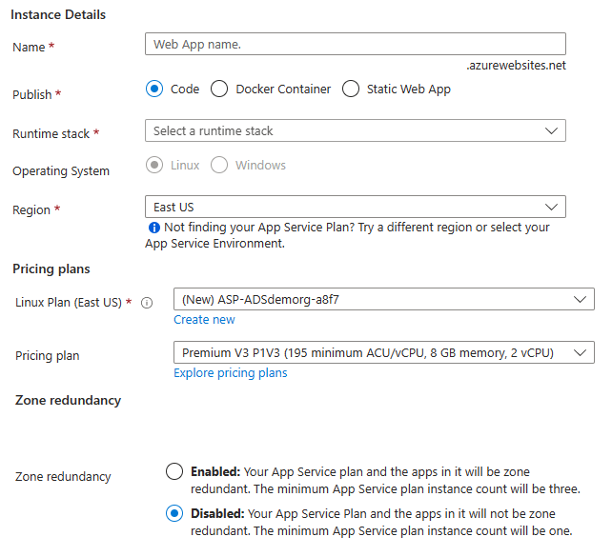
Create an App Service
Name must be unique
Access using azurewebsites.net - can map to a custom domain
Publish Code (Runtime Stack)
Publish Docker Container
Linux or Windows
Region closest to your users
App Service Plan

Slide 14



Create Deployment Slots
Continuous Deployment with Stage Slot
Service Plan | Slots
Free, Shared, Basic | 0
Standard | Up to 5
Premium | Up to 20
Isolated | Up to 20
Developer 1
GitHub
Swap
Staging
Production
Developer 2
Deploy to different deployment slots (depends on the service plan)
Validate changes before sending to production
Deployment slots are live apps with their own hostnames
Avoids a cold start - eliminates downtime
Fallback to a last known good site
Auto Swap when pre-swap validation is not needed
Notes:
Five deployment slots could be: Test, Dev, Q&A, Staging and Production
Set up staging environments - https://docs.microsoft.com/azure/app-service/web-sites-staged-publishing?toc=%2Fazure%2Fapp-service%2Ftoc.json#add-a-deployment-slot
App Service Web App – block web access to non-production deployment slots - http://ruslany.net/2014/04/azure-web-sites-block-web-access-to-non-production-deployment-slots/
✔ Each App Service plan mode supports a different number of deployment slots. To find out the number of slots your app’s mode supports, see App Service Limits.

Slide 15
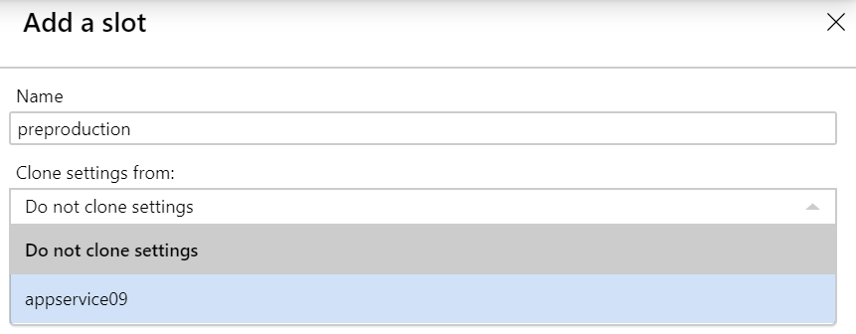
Add Deployment Slots
Select whether to clone an app configuration from another deployment slot
When you clone, pay attention to the settings:
  Slot-specific app settings and connection strings
  Continuous deployment settings
  App Service authentication settings
Not all settings are sticky (endpoints, custom domain names, SSL certificates and scaling)
Review and edit your settings before swapping

Slide 16
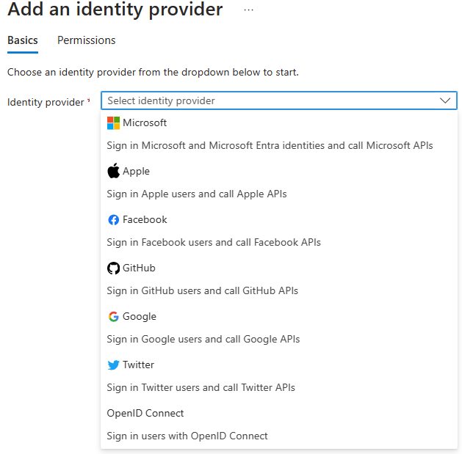
Secure an App Service
Authentication:
  Enable authentication: Default anonymous
  Log in with a third-party identity provider
Security:
  Troubleshoot with Diagnostic Logs: Failed requests and app logging
  Add an SSL certificate: HTTPS
  Define a priority-ordered allow/deny list to control network access to the app
  Store secrets in the Azure Key Vault

Slide 17
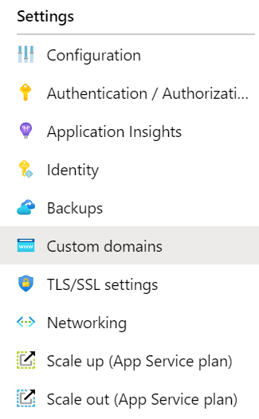
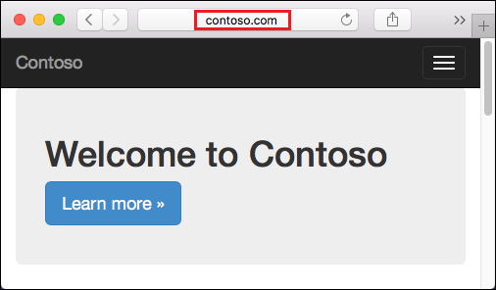
Create Custom Domain Names
Redirect the default web
app URL
Validate the custom domain in Azure
Use the DNS registry for your domain provider - create a CNAME or A record with the mapping
Ensure the App Service plan supports custom domains

Slide 18
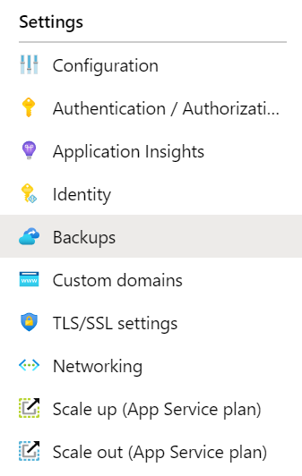
Backup an App Service
Create app backups manually or on a schedule
Backup the configuration, file content and database connected to the app
Requires a Standard or Premium plan
Backups can be up to 10 GB of app and database content
Configure partial backups, and exclude items from the backup
Restore your app on-demand to a previous state
or create a new app

Slide 19
Configure Azure App Services: Demonstration
Create a Web App in Azure Portal
Verify whether the web app is running
Explore deployment slots

Slide 20
Configure Azure Container Instances

Slide 21
Learning Objectives: Configure Azure Container Instances
Compare Containers to Virtual Machines
Understand Container Images
Review Azure Container Instances
Implement Container Groups
Configure Azure Container Instances: Demonstration
Manage Containers with Azure Container Apps
Compare container management solutions
Configure Azure Container Apps: Demonstration
Learning Recap
Implement and manage Azure compute resources (20%–25%): Create and configure containers in Azure Portal
Create and manage an Azure container registry
Provision a container using Azure Container Instances (ACIs)
Provision a container using Azure Container Apps (ACAs)
Manage sizing and scaling for containers, including ACI and ACA

Slide 22
Compare Containers With Virtual Machines
Container
Container
VM
VM
Isolation
Operating system
Deployment
Persistent storage
Fault tolerance
App A
App B
App A
App A
App B
App B
Bins/Libs
Bins/Libs
Bins/Libs
Bins/Libs
Guest OS
Guest OS
Docker Engine
Hypervisor
Host OS
Server

Slide 23
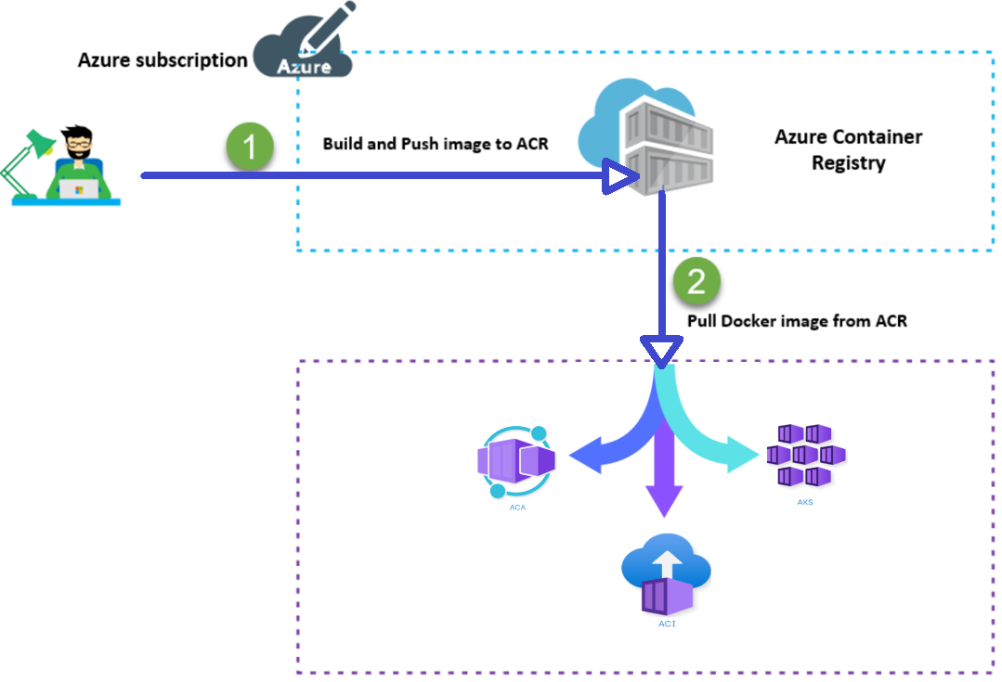
Understand Container Images
A container image is a lightweight, standalone and executable package of software that encapsulates everything needed to run an application

Slide 24
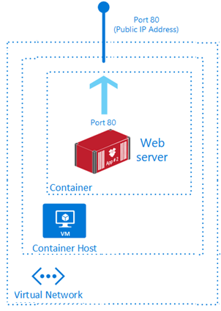
Review Azure Container Instances
PaaS Service
Fast startup times
Public IP connectivity and DNS name
Isolation features
Custom sizes
Persistent storage
Linux and Windows Containers
Co-scheduled Groups
Virtual network Deployment
Fastest way to run a container in Azure without provisioning a VM

Slide 25
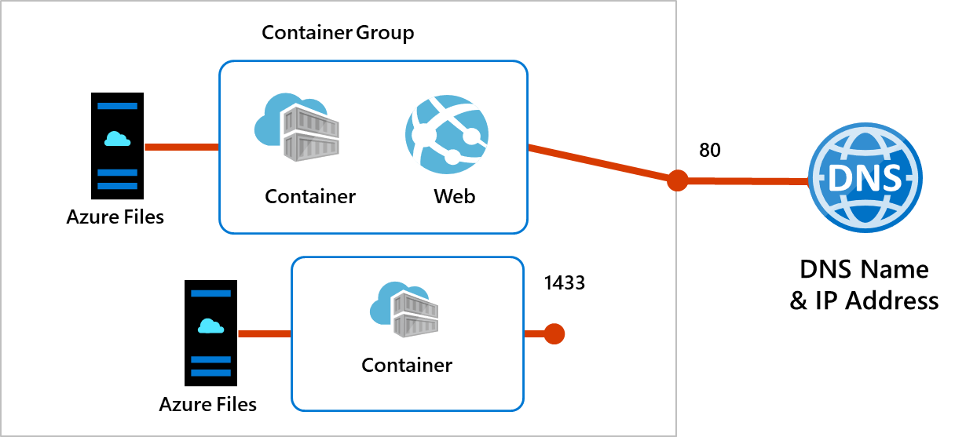
Implement Container Groups
Top-level resource in Azure Container Instances
A collection of containers
that get scheduled on
the same host
The containers in the group share a life cycle, resources, local network and storage volumes

Slide 26
Configure Azure Container Instances: Demonstration
Create and configure a container instance
Verify the deployment of the container instance

Slide 27
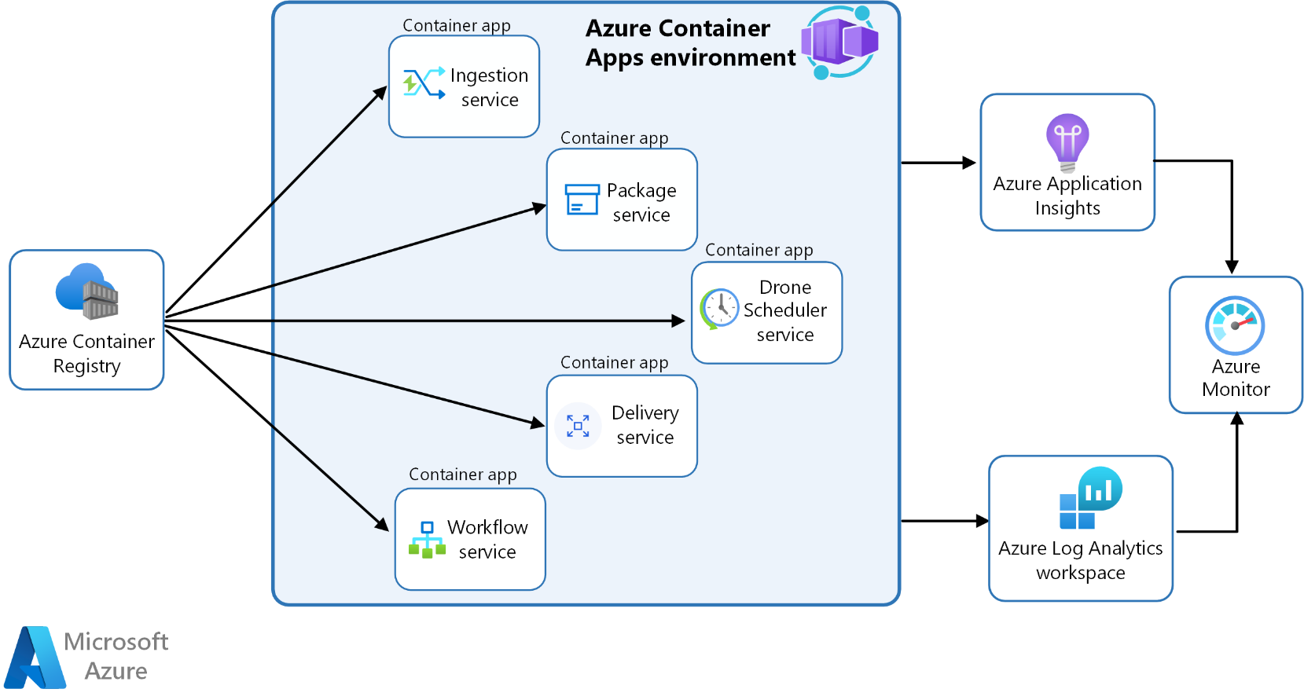
Manage Containers With Azure Container Apps
Alternative to Azure Kubernetes Service - manages container orchestration
The Container App environment creates a secure boundary around the apps and jobs
The Container App runtime manages the environment (OS upgrades, scaling, versioning and failover)

Slide 28
Compare Container Management Solutions
 | Azure Container Apps | Azure Kubernetes Service
Overview | Simplifies the deployment and management of microservices-based applications by abstracting away the underlying infrastructure | Simplifies the deployment of a managed Kubernetes cluster in Azure by offloading the operational overhead to Azure
Deployment | PaaS experience | Offers more control and customisation
Management | Fully managed by Azure | Partially managed by Azure (control plane)
Scalability | HTTP-based autoscaling and event-driven scaling | Horizontal pod autoscaling and cluster autoscaling
Use Cases | Rapid scaling and simplified management | Complex, long-running applications that require full Kubernetes features
Integration | Azure Logic Apps, Functions and Event Grid for event-driven architecture | Azure Policy for Kubernetes, Azure Monitor for containers and Azure Defender for Kubernetes for comprehensive security and governance

Slide 29
Configure Azure Container Apps: Demonstration
Create and deploy a container app
Verify whether the application URL displays the welcome message

Slide 30
Lab a: Implement Web Apps
Lab b: Implement Azure Container Instances
Lab c: Implement Azure Container Apps

Slide 31
Lab 09a: Implement Web Apps
Job Skills
Task 1: Create and configure an Azure web app
Task 2: Create and configure a deployment slot
Task 3: Configure web app deployment settings
Task 4: Swap deployment slots
Task 5: Configure and test the autoscaling of a web app
In this lab, you will learn about Azure web apps
You will learn how to configure a web app to display a Hello World application in an external GitHub repository
You will learn how to create a staging slot and swap with the production slot
You will also learn about autoscaling to accommodate demand surges
Notes:
There are 3 labs in Module 09. 09a is Web Apps. 09b is ACI. 09c is ACA.
Lab 09a - https://microsoftlearning.github.io/AZ-104-MicrosoftAzureAdministrator/Instructions/Labs/LAB_09a-Implement_Web_Apps.html

Slide 32






Lab 09a: Web App Architecture Diagram
az104-09a-rg9a
Production slot
Task 4
Task 1
Task 2
Swap
Staging slot
Task 5
App Service
App Service Plan
Task 3
Autoscale rule
Web App
External git
Hello world!

Slide 33
Lab 09b: Implement Azure Container Instances
Job Skills
Task 1: Deploy an Azure Container Instance using a Docker image
Task 2: Test and verify the deployment of an Azure Container Instance
In this lab, you will learn how to implement Azure Container Instances
You will learn how to deploy an Azure Container Instance to display a Hello World app
Notes:
Lab 09b - https://microsoftlearning.github.io/AZ-104-MicrosoftAzureAdministrator/Instructions/Labs/LAB_09b-Implement_Azure_Container_Instances.html

Slide 34


Lab 09b: Azure Container Instances Diagram
Azure Container Instances
Task 1
Task 2
Container Instance
Test and verify

Slide 35
Lab 09c: Implement Azure Container Apps
Job Skills
Task 1: Create and configure an Azure Container App and environment
Task 2: Test and verify the deployment of the Azure Container App
In this lab, you will learn how to implement Azure Container Apps
You will learn how to deploy the default Azure Container App
Notes:
Lab 09c - https://microsoftlearning.github.io/AZ-104-MicrosoftAzureAdministrator/Instructions/Labs/LAB_09c-Implement-Azure-Container-Apps.html

Slide 36


Lab 09c: Azure Container Architecture Diagram
Azure Container Apps
Task 1
Task 2
Container Apps Environment
Test and verify
Container App

Slide 37
Thank You!

